Slide 1
Getting started using Analyze 14
Guide created on behalf of Preclinical Imaging, Dept. of Comp Med, Shared Resources at Fred Hutchinson Cancer Center
Contact preclinicalimaging@fredhutch.org with any questions

Slide 2
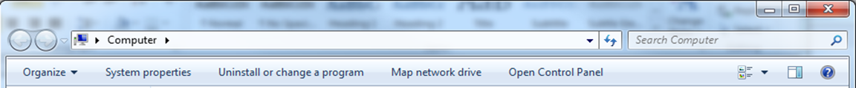
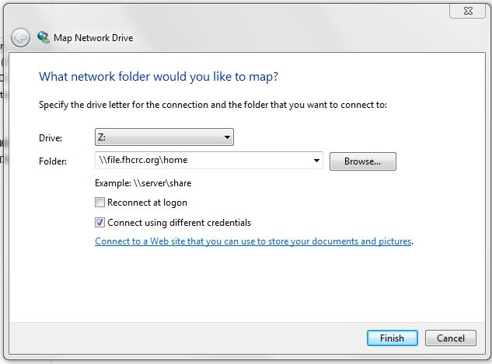
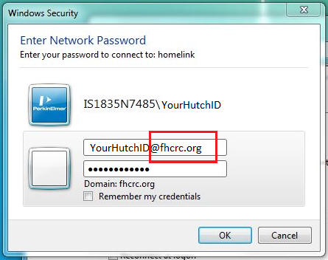
Analyze 14.0 software is located in the Arnold Library (Weintraub B1-010) on Computer #5. Log onto Computer #5 with your Hutch credentials.
First map the network drive to access your data
1.
More detailed instructions on how to do this are on display in the library
2.
3.

Slide 3
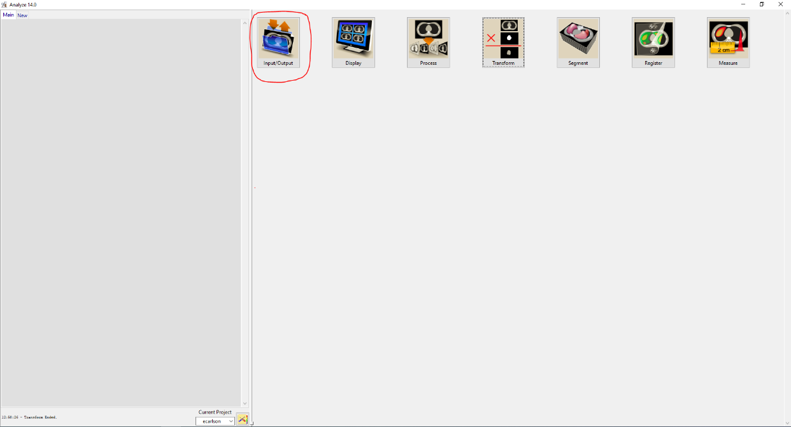
Part 1: Loading in your data
You will see “Analyze 14.0” icon on the desktop, or you can search for it in the Windows search bar.
Upon opening Analyze, you should see this screen.
Click on the Input/Output box (circled in red)

Slide 4
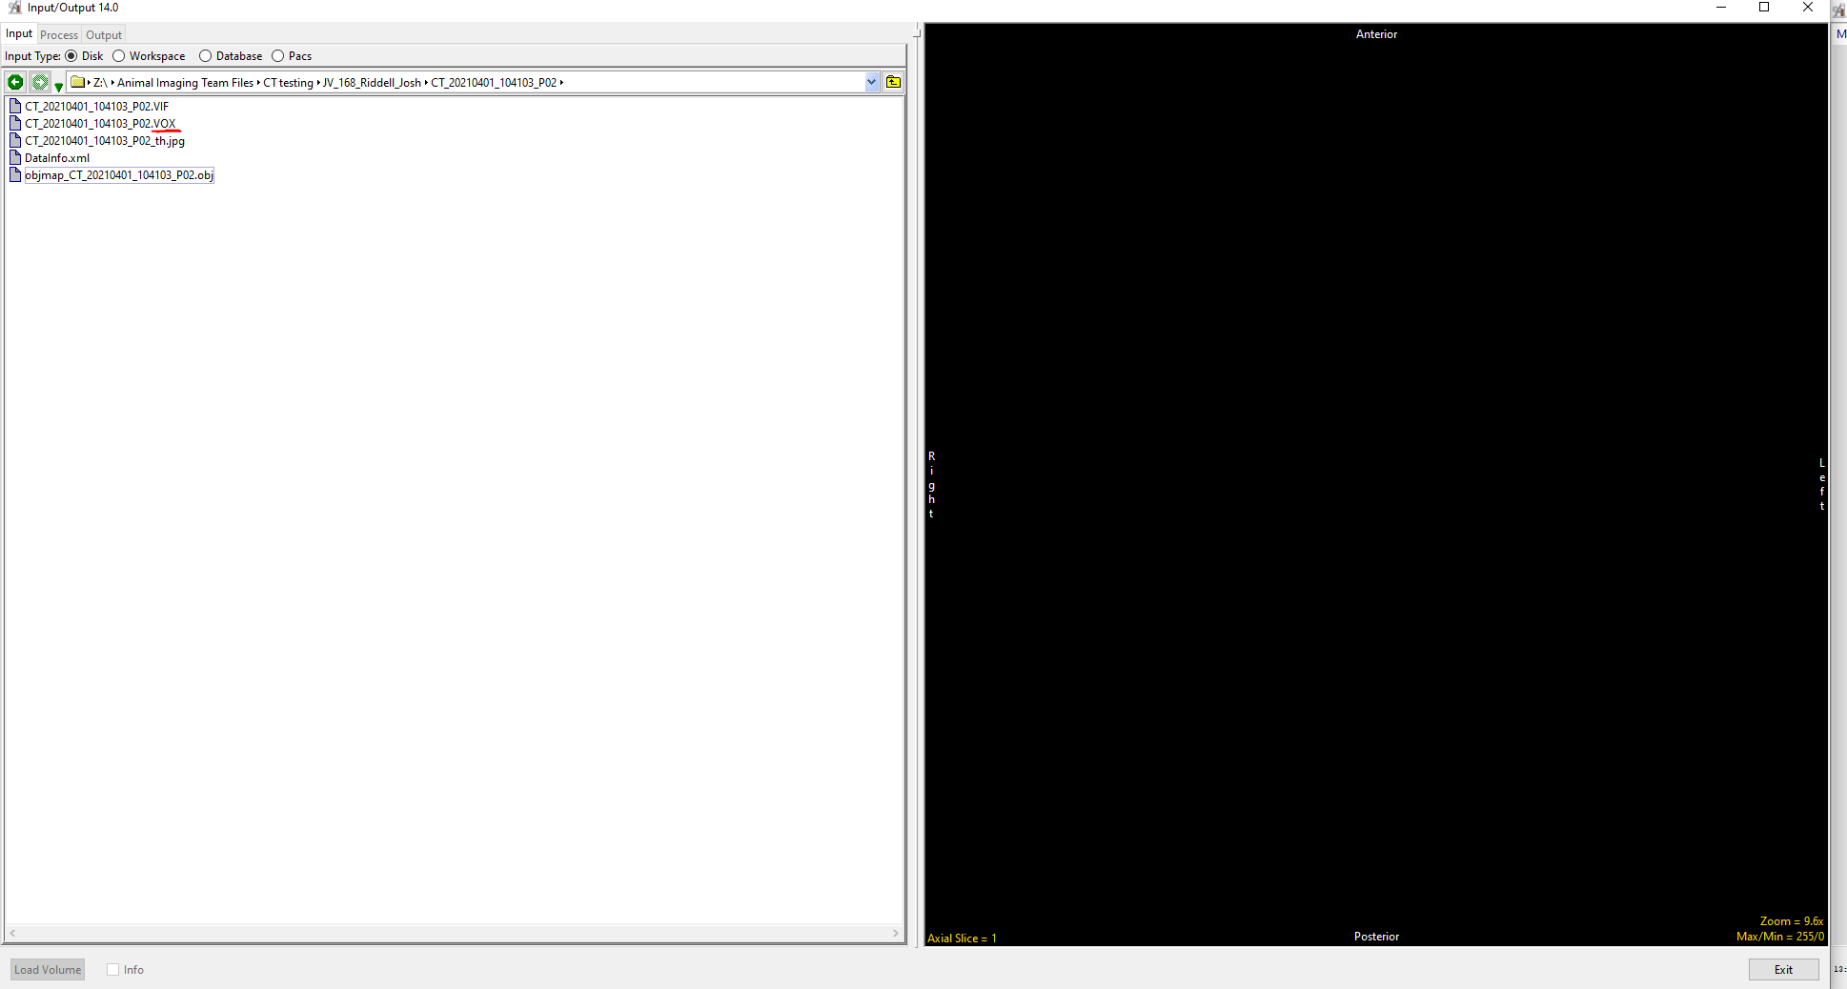
Set path to folder containing data you want to look at
You will need to manually type in Z:\ to the address bar
3. Click on the file you wish to open. This will likely be a .VOX file.
The acquisition software for the microCT always yields .VOX files. If you request it, you may also have exported other file formats (like .TIFF or DICOM). Analyze can work with these file formats, but there is no real need to do this (and doing so takes up a lot more space on the hard drive).
For info on loading other data file types, see the last slide for further resources.

Slide 5
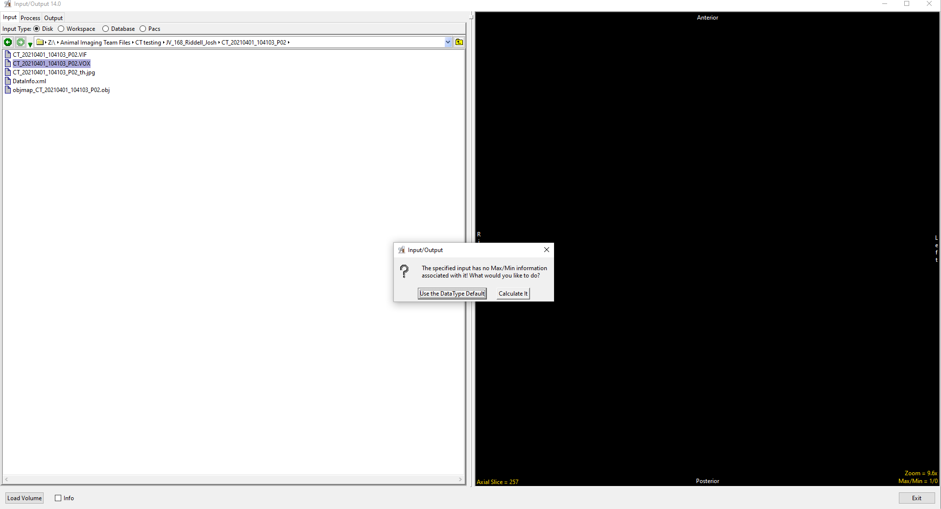
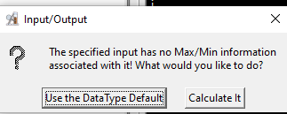
1. Click ‘Load Volume’.
2. You may receive this message. Select ‘Calculate It’. If you want to know why we should choose this, see the notes section of this slide
More complex & specialized transformations can be performed while loading the data in by selecting the “Process” tab. More details can be found on these import options elsewhere (see
The last slide). For the basic data import of .VOX files this should be avoided.
Notes:
From Analyze support team:
“Some .VOX files do not have the header info for max/min signal intensities, so this message comes up when that happens. The best option to choose is ‘Calculate It’, as in doing this, the max/min in the loaded AVW volume image will then properly be set to describe the dynamic range of the signal intensities. Note that this does nothing to the image values themselves – nothing is changed in those values – just the max/min for the range of values is saved in the volume header info. This makes any signal value based manipulations such as thresholding or windowing much easier and more relevant to the actual range of the data values.”

Slide 6
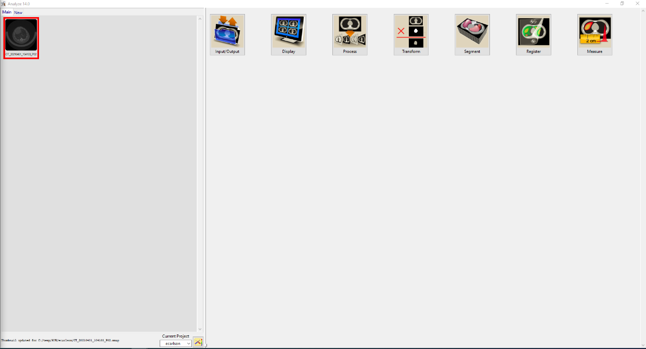
The dataset should now be loaded in the Analyze workspace.
Click on the dataset then you can click another analysis method to open in a new window (i.e. ‘Segment’, Measure, etc).
See the last slide for resources on how to use these processes. We will not go into those details here as what you will need for your study’s analysis will be highly variable depending on your study design.

Slide 7
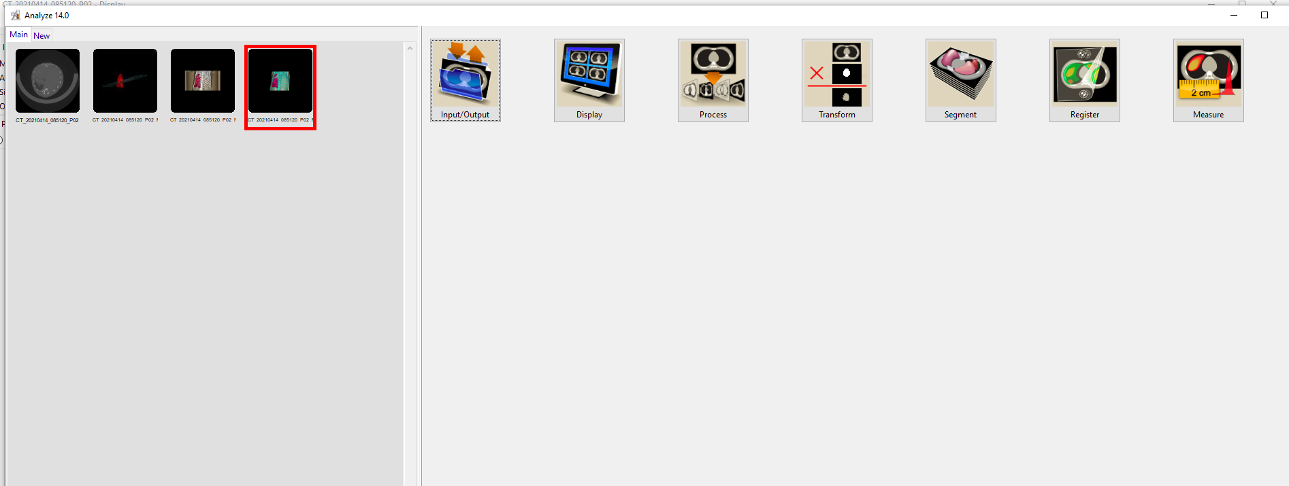
Part 2: Saving your work & saving files in Analyze
1. After working up data and performing analysis, click on the file you would like to save. (for instance, here I want to save this sequence of images to be exported as a video)
2. With file highlighted in red (as shown), select “Input/Output” tab

Slide 8
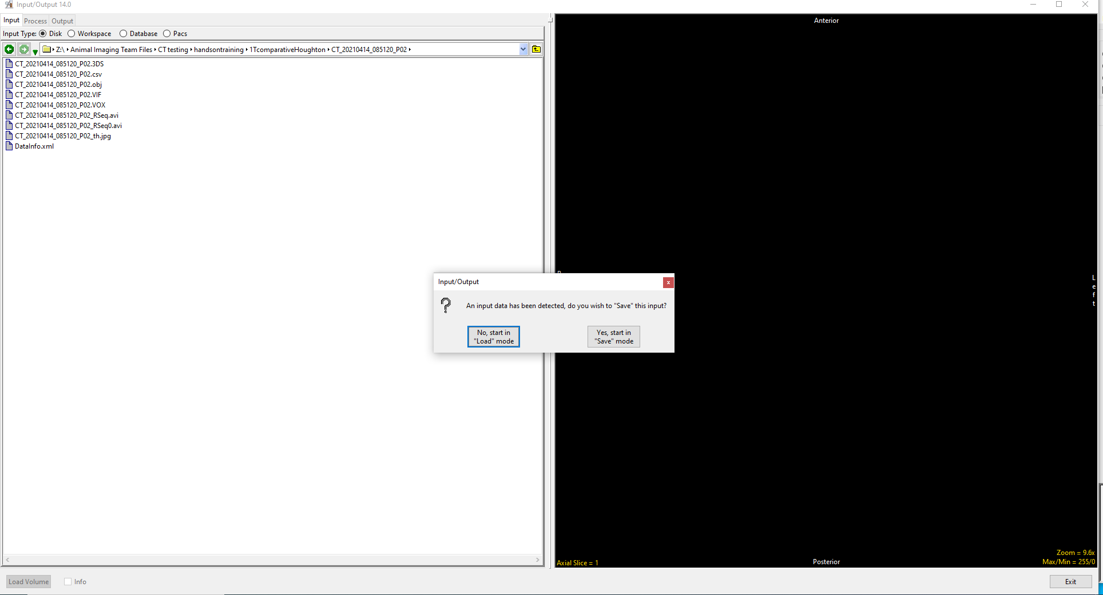
A new window will pop up
Ensure you are in correct folder – this is where the file will be saved
Select ‘Yes, start in “Save” mode’ to save the file.
(if you did not want to save the file but wanted to load in a new file you would select ‘No, start in “Load” mode’)

Slide 9
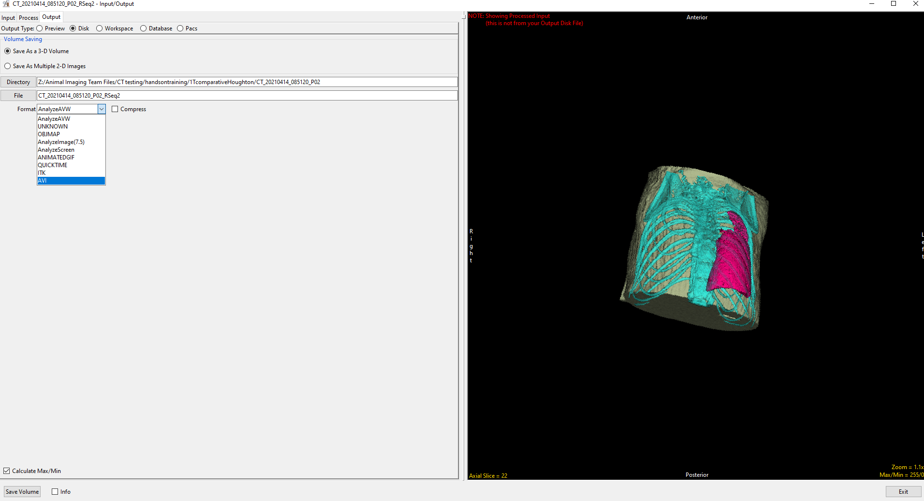
1. Here you determine what filetype you’d like the resulting export to be in. The selection options here will depend on what type of information you are saving.
You can change the name of the file in the “File” box and the directory via the “Directory” box.
Here, I want to save this sequence of images as an .AVI video file.
2. Leave “Calculate Max./Min.” checked
3. Press “Save Volume”. When finished, you should see the file in the desired folder.

Slide 10
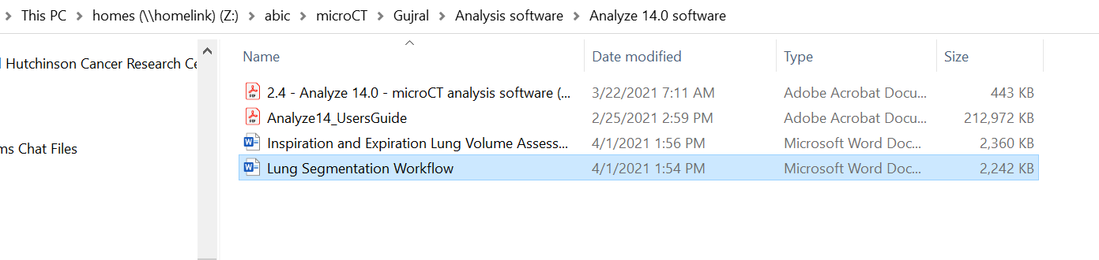
More resources
Helpful videos from Analyze 14.0’s Youtube channel:
Analyze 14.0 Overview - https://youtu.be/v4rUN9CHJSY
Input/Output Playlist - https://www.youtube.com/playlist?list=PLbpl_y6g8PSL-3O9OzvoO7AjRNLyzvLbH
Analysis methods playlists - https://www.youtube.com/user/AnalyzeDirect/playlists
(particularly the Segment, Measure, Register, Process playlists for knowledge on working up data for your own particular project)
Analyze 14 User’s User’s Guide - https://analyzedirect.com/analyze-users-guide/
Lung Segmentation workflow document – uploaded to your lab’s microCT folder (see below)
Your
Lab
Notes:
Object separator for removing bed in segmentation rendering: https://www.youtube.com/watch?v=a222PPEkOfA

